Slide 1
IS 221: ICT RESEARCH METHODS
Lecture 3
April 2024

Slide 2
Sitting Arrangement
Sit in groups based on your programmes
  BSc. CNISE on one side
  BSc. MTA on one side
  BSc. IS on one side
This will help in executing classroom activities as the activities will involve working in groups with similar interests
Dr. Lucian Ngeze, CIVE

Slide 3
Homework for Lecture 1
Watch the following three videos
  Intro to Res: https://youtu.be/btZE1COWF5o?si=J3i-eGnCD2XN_6Gt
  Res Process: https://youtu.be/07nYgNTWz7Q?si=KqwzGkOMmvWX164o
  Res Design: https://youtu.be/LpmGSioXxdo?si=aU7KLqlbzW6A6EZc
Using your notebook, note three (3) new terms/words from each video that you come across as you watch the videos [You will present 9 new words from the 3 videos]
Be ready to share with the rest of the class
1 week
Dr. Lucian Ngeze, CIVE, UDOM

Slide 4
Prep work for Lecture 2 (How many have done?)
1. Research Problem: .......
2. Write your Research Title: .......
3. Write your Research Aim: .......
4. Write your (Main and Specific) Res Objectives: .......
5. Write your Research Questions: .......
6. Search for 5 relevant literatures from Google Scholar. Note them down: .......
7. Read the 5 papers and note down the res gap: .......
8. My 6 new research words are:: .......
3 days
Dr. Lucian Ngeze, CIVE

Slide 5

New keywords?
https://padlet.com/lucianngeze/what-are-new-keywords-that-you-have-come-across-as-you-watch-uhsy2bgd6prsog39
Dr. Lucian Ngeze, CIVE

Slide 6
Learning Objectives for Lecture 2
By the end of the class session (2 hrs), you will be able to:
  Formulate research problems
  Formulate Research Titles
  Formulate Problem Statements
  Create Research Objectives
Dr. Lucian Ngeze, CIVE

Slide 7

Rule of Engagement During IS 221 Class
No laptops, no cell phones during lecture
…until when I instruct you to use them
…put your devices on the table
Are you ready? Can we start?
Dr. Lucian Ngeze, CIVE

Slide 8

Class Activity 1: Steps for Research
Individually respond to the following question
Chronologically, list the steps to conduct research
Share with the rest of the class
2 Minutes
Dr. Lucian Ngeze, CIVE

Slide 9

Research process
Step 1: Identify the research problem: This involves identifying a gap in knowledge or an issue that needs to be addressed through research.
Dr. Lucian Ngeze, CIVE

Slide 10

Research process
Step 2: Develop research questions or hypotheses: Based on the research problem and literature review, the researcher formulates research questions or hypotheses that they will address through their study.
Dr. Lucian Ngeze, CIVE

Slide 11

Research process
Step 3: Conduct a literature review: This involves reviewing existing research studies and publications related to the research problem to identify what has already been done and what is still unknown.
Dr. Lucian Ngeze, CIVE

Slide 12

Research process
Step 4: Design the study: This involves determining the research design, methods for data collection, and sampling strategy. The researcher also needs to ensure that ethical considerations are addressed.
Dr. Lucian Ngeze, CIVE

Slide 13

Research process
Step 5: Collect data: This involves collecting data using the selected research methods, such as surveys, experiments, interviews, or observation.
Dr. Lucian Ngeze, CIVE

Slide 14

Research process
Step 6: Analyze data: This involves analyzing the collected data using appropriate statistical or qualitative analysis techniques to answer the research questions or test the hypotheses.
Dr. Lucian Ngeze, CIVE

Slide 15

Research process
Step 7: Interpret findings: This involves interpreting the results of the data analysis and drawing conclusions based on the findings.
Dr. Lucian Ngeze, CIVE

Slide 16

Research process
Step 8: Report results: This involves writing up the research study in a formal report or manuscript, which includes the research problem, literature review, methodology, results, and conclusions.
Dr. Lucian Ngeze, CIVE

Slide 17
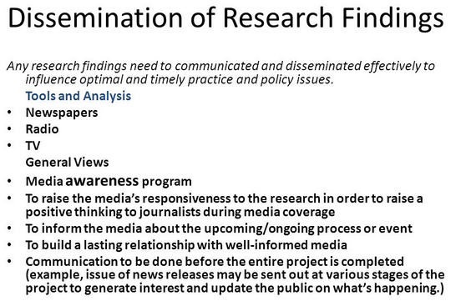
Research process
Step 9: Disseminate findings: This involves sharing the results of the research study with other researchers, practitioners, and stakeholders through conferences, publications, or other means.
Dr. Lucian Ngeze, CIVE

Slide 18
LET US UNPACK EACH RESEARCH STEP
Dr. Lucian Ngeze, CIVE

Slide 19
STEP 1: PROBLEM IDENTIFICATION
THE SCIENTIFIC RESEARCH PROCESS
Step 1
Step 2
Step 3
Step 9
Dr. Lucian Ngeze, CIVE

Slide 20
Class Activity 2: Steps for Research
Individually respond to the following question
How did you come up with the problem to research on?
Share with the rest of the class
2 Minutes
Dr. Lucian Ngeze, CIVE

Slide 21
Sources of Research Problems
The identification of a problem to study can be challenging, not because there's a lack of issues that could be investigated, but due to the challenge of formulating an academically relevant and researchable problem which is unique and does not simply duplicate the work of others.
To facilitate how you might select a problem from which to build a research study, consider these sources of inspiration:
Dr. Lucian Ngeze, CIVE

Slide 22
Sources of Research Problems
1. From your interests
One way to find a research problem is to explore your own interests and passions.
  What topics or issues are you curious about?
  What problems do you want to solve or questions do you want to answer?
You can start by brainstorming, reading, or discussing with others.
You can also review the literature in your field to see what others have done and what gaps or controversies exist.
Dr. Lucian Ngeze, CIVE

Slide 23
Sources of Research Problems
2. Personal Experience
Don't undervalue your everyday experiences or encounters as worthwhile problems for investigation.
Think critically about your own experiences and/or frustrations with an issue facing society, your community, your neighborhood, your family, or your personal life.
Dr. Lucian Ngeze, CIVE

Slide 24
Sources of Research Problems
3. Consultation/Interviewing with Practitioners/Experts
The identification of research problems about particular topics can arise from formal interviews or informal discussions with practitioners/experts who provide insight into new directions for future research and how to make research findings more relevant to practice.
Discussions with experts in the field, such as, teachers, social workers, health care providers, lawyers, business leaders, etc., offers the chance to identify practical, “real world” problems that may be understudied or ignored within academic circles.
This approach also provides some practical knowledge which may help in the process of designing and conducting your study.
Dr. Lucian Ngeze, CIVE

Slide 25
Sources of Research Problems
4. Demand from the people/community
‘Knowledge does not hang in space; it is a product of social processes (Bouma and Ling, 2006:3).’ In order to have a strong community there must be a certain system of functionality regulating the lives of the general mass.
Now, when social system breaks down the lives of the public is affected.
The breakdown of the system could manifest in the form of discontentment leading to the disruption in both private and public life.
This disruptive situation produces a demand for a well researched body of knowledge.
Researchers take to task the tested situation(s) of the people/community to produce adequate knowledge which could help in finding a remedy for the people.
Dr. Lucian Ngeze, CIVE

Slide 26
Sources of Research Problems
5. Review of Previous Studies (Literature Review)
The selection of a research problem can be derived from a thorough review of pertinent research associated with your overall area of interest.
This may reveal where gaps exist in understanding a topic or where an issue has been understudied.
Research may be conducted to:
  Fill such gaps in knowledge;
  Evaluate if the methodologies employed in prior studies can be adapted to solve other problems;
  Determine if a similar study could be conducted in a different subject area or applied in a different context or to different study sample [i.e., different setting or different group of people].
Dr. Lucian Ngeze, CIVE

Slide 27
Activity 1: Research Title Formulation
Dr. Lucian Ngeze, CIVE

Slide 28
Class Activity 3: Steps for Research
Individually, take 1 min to think on your research title you submitted to me
What did you think of first when formulating your research title?
Share with the rest of the class
2 Minutes
Dr. Lucian Ngeze, CIVE

Slide 29
Tips on Formulating a Good Research Title
A research paper title summarizes the aim and purpose of your research study.
Making a title for your research is one of the most important decisions when writing an article to publish in journals.
A good title does several things:
  It predicts content.
  It catches the reader's interest.
  It reflects the tone or slant of the piece of writing.
  It contains keywords that will make it easy to access by a computer search
Dr. Lucian Ngeze, CIVE

Slide 30
Working Title and Good Research Title
When you finish Research
When you begin Research
Refinement During Research
Working Research Title
Good Research Title
Dr. Lucian Ngeze, CIVE

Slide 31
Tips on Formulating a Good Research Title
The title needs to be simple, precise and direct
Include all of the essential terms in your paper
It should be specific, concise, accurate, and functional
Avoid unnecessary jargon and abbreviations
Use keywords that capture the content of your paper
It should include Setting, Population, Intervention, Condition, End-point, and Design
Not too long and not too short (15-20 words)
Write the title after you’ve written your paper and abstract
Dr. Lucian Ngeze, CIVE

Slide 32
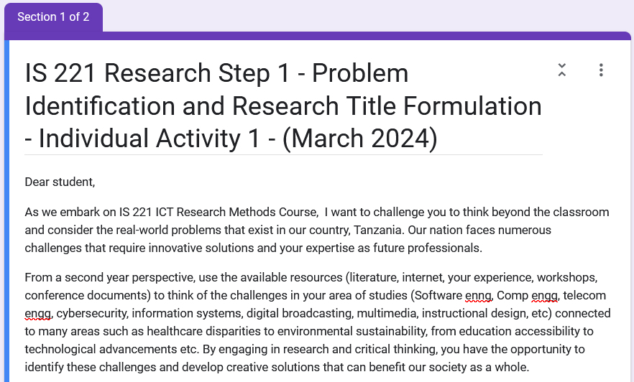
Individual Activity 1
Dr. Lucian Ngeze, CIVE

Slide 33
Components of a Research Title
A research title should contain several key elements to effectively convey the focus and significance of the study.
Here are the main elements that a research title should include:
Dr. Lucian Ngeze, CIVE

Slide 34
Components of a Research Title
Main Factors Studied:
  Clearly state the main factors, variables, or concepts that are the focus of your research
Context Studied:
Population
  Specify the population or clinical context under investigation in your study.
  This helps readers understand the scope and relevance of your research
Study Design:
  Mention the design of your study, such as whether it is a randomized controlled trial, cohort study, case-control study, etc.
  This provides important information about the methodology used in your research
Main Findings:
  Highlight the main findings or outcomes of your study.
  This gives readers a glimpse of the results and conclusions of your research
Dr. Lucian Ngeze, CIVE

Slide 35
Examples of Research Titles in Education
Title: "The Impact of Technology Integration on Student Engagement in Mathematics Education"
  Main Factors Studied: Technology Integration, Student Engagement
  Population/Context Studied: Mathematics Education
  Study Design: Not specified
  Main Findings: Impact of Technology Integration on Student Engagement
Dr. Lucian Ngeze, CIVE

Slide 36
Examples of Research Titles in Education
Title: "Exploring the Effects of Peer Tutoring on Reading Comprehension in Elementary School Students“
  Main Factors Studied: Peer Tutoring, Reading Comprehension
  Population/Clinical Context Studied: Elementary School Students
  Study Design: Exploring the Effects
  Main Findings: Effects of Peer Tutoring on Reading Comprehension
Dr. Lucian Ngeze, CIVE

Slide 37
Examples of Research Titles in Education
Title: "A Comparative Analysis of Traditional vs. Online Learning Environments in Higher Education“
  Main Factors Studied: Traditional Learning, Online Learning Environments
  Population/Clinical Context Studied: Higher Education
  Study Design: Comparative Analysis
  Main Findings: Comparison of Traditional vs. Online Learning Environments
Dr. Lucian Ngeze, CIVE

Slide 38
Examples of Research Titles in Education
Title: "The Role of Parental Involvement in Student Academic Achievement: A Case Study of Urban Schools“
  Main Factors Studied: Parental Involvement, Student Academic Achievement
  Population/Clinical Context Studied: Urban Schools
  Study Design: Case Study
  Main Findings: Role of Parental Involvement in Student Academic Achievement
Dr. Lucian Ngeze, CIVE

Slide 39
Section 2: Formulating Problem Statement
Dr. Lucian Ngeze, CIVE

Slide 40
Formulating Problem Statements
A persuasive problem statement consists of FOUR parts:
  the ideal,
  the reality, and
  the consequences
  Research part
Well constructed problem statements will convince your audience that the problem is real and worth having you investigate.
Dr. Lucian Ngeze, CIVE

Slide 41
Formulating Problem Statements
STATEMENT 1 (DESCRIPTION OF THE IDEAL SCENARIO)
Describe the goals, desired state, or the values that your audience considers important and that are relevant to the problem.
(BUT)
Connect statements 1 and 2 using a term such as "but," "however,“ "Unfortunately," or "in spite of";
STATEMENT 2 (THE REALITY OF THE SITUATION)
Describe a condition that prevents the goal, state, or value discussed in statement 1 from being achieved or realized at the present time.
Dr. Lucian Ngeze, CIVE

Slide 42
Formulating Problem Statements
STATEMENT 3 (THE CONSEQUENCES FOR THE AUDIENCE)
Using specific details, show how the situation in statement 2 contains little promise of improvement unless something is done.
Then emphasize the benefits of research by projecting the consequences of possible solutions as well.
RESEARCH (YOUR PROPOSED RESEARCH TO INVESTIGATE THE POSSIBILITY OF MAKING THE REALITY MORE LIKE THE IDEAL.)
Describe the areas of inquiry you will use that could lead to solutions to the problem--- how will you research the problem?
What sources of information, types of research (primary or secondary),or tools will you use to help you find solutions and make recommendations to resolve the clash?
Dr. Lucian Ngeze, CIVE

Slide 43
Problem Statement-Example 1
STATEMENT 1 (IDEAL)
In order to provide excellent patient care at a minimal cost, Middletown Hospital needs diagnostic procedures that are safe, efficient, and accurate. In addition, the procedures should not be overly painful for the patient.
STATEMENT 2 (REALITY)
Right now, Middletown Hospital's main diagnostic tools are CAT scans and myelograms (spinal taps). The CAT scan fails to make clear diagnoses 60% of the time. When the CAT scan fails, doctors must resort to the myelogram. While the myelograms are accurate, this procedure is very painful and sometimes dangerous for the patient.
Dr. Lucian Ngeze, CIVE

Slide 44
Problem Statement-Example 1
STATEMENT 3 (CONSEQUENCES)
If Middletown Hospital continues to do the two procedures, they will not only be wasting time and money, which jeopardizes their overall efficiency and earning potential. Also, undue suffering could lead patients to choose another hospital with more advanced facilities.
RESEARCH (PROPOSED RESEARCH TO SOLVE THE PROBLEM)
A new diagnostic technique, nuclear magnetic resonance (NMR) may surpass the CAT scan in accuracy and reduce the need to resort to the myelogram. I propose to research the feasibility of establishing an NMR lab at Middletown hospital. I will investigate the accuracy, efficiency, and safety of NMR as well as implementation issues.
Dr. Lucian Ngeze, CIVE

Slide 45
Problem Statement-Example 1
In order to provide excellent patient care at a minimal cost, Middletown Hospital needs diagnostic procedures that are safe, efficient, and accurate. In addition, the procedures should not be overly painful for the patient.
Right now, Middletown Hospital's main diagnostic tools are CAT scans and myelograms (spinal taps). The CAT scan fails to make clear diagnoses 60% of the time. When the CAT scan fails, doctors must resort to the myelogram. While the myelograms are accurate, this procedure is very painful and sometimes dangerous for the patient.
If Middletown Hospital continues to do the two procedures, they will not only be wasting time and money, which jeopardizes their overall efficiency and earning potential. Also, undue suffering could lead patients to choose another hospital with more advanced facilities.
A new diagnostic technique, nuclear magnetic resonance (NMR) may surpass the CAT scan in accuracy and reduce the need to resort to the myelogram. I propose to research the feasibility of establishing an NMR lab at Middletown hospital. I will investigate the accuracy, efficiency, and safety of NMR as well as implementation issues.
Statement1
(The Ideal)
Statement2
(The reality)
Statement3
(Consequences)
Research
(Your Research)
Dr. Lucian Ngeze, CIVE

Slide 46
Problem Statement-Example 2
Audience
This proposal is directed to Alfred Academy’s headmaster, Dr. Smith Nyman. Alfred Academy is a private high school with approximately 200 students in attendance. Dr. Nyman is the primary liaison between the administration, the students and their parents. Nyman works with private educational funds and the alumni in order to raise money for student programs, e.g., a lecture series. Nyman then creates a task force of parents and students who execute the program for him.
In order to continue the fifty-year tradition of pacifist values, Alfred Academy's administration needs a multifaceted mediation program that includes the administration, the faculty, the students and the students' parents. This mediation program needs to (1) serve as a preventative measure, (2) encourage peaceful interactions, and (3) adapt to the changing needs of the school.
Currently, Alfred has three mediation, i.e., problem solving, resources: (1) an unofficial peer mediation group, (2) an unofficial student court, and (3) a lecture program entitled Peaces. Unfortunately, at the present time, only one of those three methods are being utilized: lectures. These lectures are not mandatory as a result, the majority of students do not attend. Furthermore, neither the peer mediation group nor the student court are legally certified and are, therefore, not credible resources and remain unused.
Without an effective mediation program to help Alfred Academy achieve its educational goals, violence will continue to escalate. A new, interactive approach to non-violent problem solving is needed. A long-term mediation-training program may help the administration to (1) reinstate the school’s pacifist values, (2) prevent aggressive behavior from escalating, and (3) promote peaceful interactions in the school. Current mediation programs are both abundant and diverse in nature.
I propose to examine the advantages and disadvantages of the various current mediation-training programs to determine which adequately suits Alfred’s present and future needs.
Statement1
Statement2
Statement3
Research
Dr. Lucian Ngeze, CIVE

Slide 47
Problem Statement-Example 3
Ideally, the mission of the University Park Allocation Committee is dedicated to allocating both University General Funds money as well as a portion of the Student Activity Fee income. These funds are made available in order to enhance student life and the out-of-class experience or improve the educational climate at University Park.
One of the main focuses of the committee is consistency. Unfortunately, consistency in allocating funds to student organizations requires prior knowledge of previous allocations and established practices. The current internal rotation system allows committee members the ability to experience all four sub-committees, but in an extremely quick and arbitrary manner.
Continuing with this current rotation system prevents consistency and causes decisions to become grossly political, which in turn inhibits the committee of fully enhancing the out-of-class experience of the students at University Park. Developing a more informed rotation system could allow the committee to still fulfill the mission statement of the committee.
I would like to explore options for a new internal rotation system that would focus on consistency. To do this, I will consult with representatives from two other big-ten universities to look at how students are involved in the allocations decisions. I will also survey existing members of PSU’s committee to find out preferences as well as how long it would take for each member to familiarize themselves with student organizations.
Statement1
Statement2
Statement3
Research
Dr. Lucian Ngeze, CIVE

Slide 48
Class Activity 4: Problem Statement
With your neighbor
Write four paragraphs of Problem Statement Section of your Research.
Write the paragraphs in your notebook
Share with the rest of your class
10 minutes
Dr. Lucian Ngeze, CIVE

Slide 49
THE SCIENTIFIC RESEARCH PROCESS
Step 1
Step 2
Step 3
Step 9
STEP 2: CREATE RESEARCH OBJECTIVES, RESEARCH QUESTIONS/ RESEARCH HYPOTHESES
Dr. Lucian Ngeze, CIVE

Slide 50
Section 2.1: Research Objectives
Dr. Lucian Ngeze, CIVE

Slide 51
RESEARCH OBJECTIVES
To Avoid the collection of data which are not strictly necessary for understanding and solving the problem we have identified
To Focus the study (narrowing it down to essentials);
To Organize the study in clearly defined parts or phases
They are crucial in any research since they determine the kind of questions and procedures to be used in data collection, and analysis
Dr. Lucian Ngeze, CIVE

Slide 52
Research Objectives
Research objectives describe what your research project intends to accomplish.
They should guide every step of the research process including how you collect data, build your argument, and develop your conclusions.
Your research objectives may evolve slightly as your research progresses, but they should always line up with the research carried out and the actual content of your paper.
Dr. Lucian Ngeze, CIVE

Slide 53
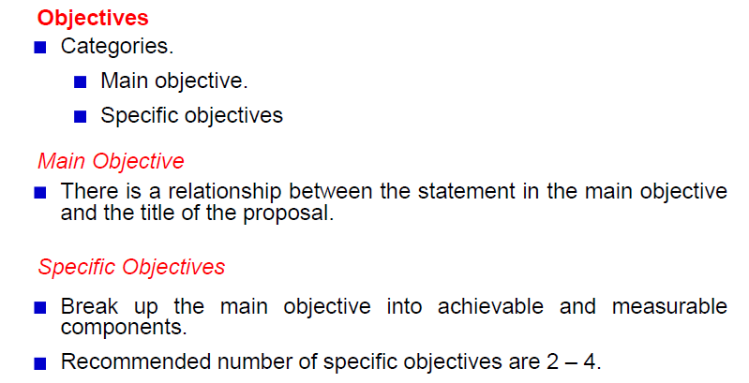
Research Objectives
Dr. Lucian Ngeze, CIVE

Slide 54
Main/General Objective
The general objective of your study states what you expect to achieve in general terms.
It states what researchers expect to achieve by the study in general terms
Dr. Lucian Ngeze, CIVE

Slide 55
Main/General Objective
Main Objective 1
The main objective of this project is to develop an online course that guides school teachers on the effective use of their mobile devices to improve teaching and learning.
Dr. Lucian Ngeze, CIVE

Slide 56
Specific Objectives
Specific objectives break down the general objective into smaller, logically connected parts that systematically address the various aspects of the problem.
Your specific objectives should specify exactly what you will do in each phase of your study, how, where, when and for what purpose.
Properly formulated specific objectives will facilitate the development of our research methodology and will help to orient the collection, analysis, interpretation and utilization of data
Dr. Lucian Ngeze, CIVE

Slide 57
Specific Objectives
How to Write Objectives
Your objectives should be stated using action verbs that are specific enough to be measured, for example: to compare, to calculate, to assess, to determine, to verify, to calculate, to describe, to explain, etc.
Avoid the use of vague non-active verbs such as: to appreciate, to understand, to believe, to know, to visualize, to study, etc., because it is difficult to evaluate whether they have been achieved.
Dr. Lucian Ngeze, CIVE

Slide 58
Relationship btn Main and Specific Objectives
MAIN OBJECTIVE
Specific Objective 1
Specific Objective 2
Specific Objective N
Dr. Lucian Ngeze, CIVE

Slide 59
Specific Objectives
Main Objective: The main objective of this project is to develop an online course that guides school teachers on the effective use of their mobile devices to improve teaching and learning.
Specific Objectives
To conduct need analysis in order to get audiences’ requirements.
To design an online course based on the analysed requirements
To develop an online course based on the data from objective two.
To implement the course in the LMS for teachers to enroll.
Dr. Lucian Ngeze, CIVE

Slide 60
Research Objectives
Main Objective 2
To develop a mathematics instructional application with gamification features for Form One Students
Dr. Lucian Ngeze, CIVE

Slide 61
Research Objectives
Main Objective: To develop a mathematics instructional application with gamification features for Form One Students
Specific Objectives
To analyse the first three topics of form 1 Maths syllabus and its subtopics.
To design a graphical user interface (GUI) that engages students and has gamification features.
To implement an instructional application that incorporates mathematics instructional content using the Unity engine.
To review the final application on the Windows and Android platforms.
Dr. Lucian Ngeze, CIVE

Slide 62
Class Activity 5: Writing Main Objective
Group Yourselves in your respective groups
Write Main Objective for your Research Title
Present to the rest of the class
5 minutes
Dr. Lucian Ngeze, CIVE

Slide 63
Class Activity 6: Writing Specific Objectives
Group Yourselves in your respective groups
Write 3 Specific Objectives for your Research Title
Present to the rest of the class
5 minutes
Dr. Lucian Ngeze, CIVE

Slide 64
SMART Objectives
SMART objectives are:
Specific: Concrete, detailed, and well defined so that you know where you are going and what to expect when you arrive
Measureable: Numbers and quantities provide means of measurement and comparison
Achievable: feasible and easy to put into action
Realistic: Considers constraints such as resources, personnel, cost, and time frame
Time-Bound: A time frame helps to set boundaries around the objective
Dr. Lucian Ngeze, CIVE

Slide 65
More resources on SMART Objectives
Read more about smart objectives here:
https://www.questionpro.com/blog/smart-objectives-and-goals/
SMART Objectives: https://youtu.be/1T3o-ruJ8uA
SMART Goals: https://youtu.be/1-SvuFIQjK8
SMART Goals 2: https://youtu.be/PCRSVRD2EAk
Dr. Lucian Ngeze, CIVE

Slide 66
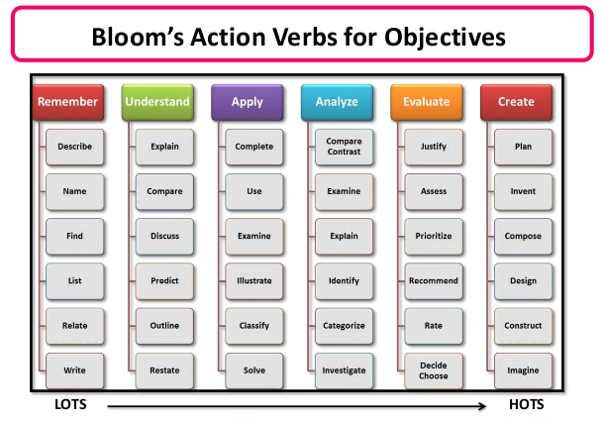
Bloom’s
Taxonomy
Dr. Lucian Ngeze, CIVE

Slide 67
More about Action verbs
Resource 1: https://www.valamis.com/hub/blooms-taxonomy
Resource 2: https://teachingutopians.com/2019/06/28/everything-teachers-need-to-know-about-blooms-taxonomy/?fbclid=IwAR1XRQ6LHQ62SqdaMl7y_H9POo63BGpSpndg0s81mCI-OObkKGW2krpc9fw
Dr. Lucian Ngeze, CIVE

Slide 68
Research Title formulations in Engineering and Technology
Descriptive Titles (What the Study Is About)
Design and Implementation of a Solar Microgrid System for Electrification in Remote Tanzanian Villages
Development of an IoT-Based Air Quality Monitoring System for Urban Environments in Dar es Salaam
Construction and Testing of a Low-Cost Water Filtration Unit for Use in Rural Health Centers
Development of a Drone-Based Surveillance System for Forest Monitoring in Protected Areas of Tanzania
Design of a Smart Traffic Light System for Reducing Congestion in Arusha City
Dr. Lucian Ngeze, CIVE

Slide 69
Research Title formulations in Engineering and Technology
2. Cause-Effect / Relationship Titles
Impact of IoT-Based Irrigation Systems on Water Use Efficiency in Small-Scale Farming in Dodoma
Relationship Between Solar Panel Orientation and Energy Output in Off-Grid Systems in Coastal Tanzania
Effects of Automation on Productivity in Medium-Sized Manufacturing Plants in Morogoro
Influence of AI-Powered Diagnostic Tools on Error Reduction in Hospital Laboratories
Effect of Sensor Network Density on the Accuracy of Environmental Monitoring Systems in Urban Areas
Dr. Lucian Ngeze, CIVE

Slide 70
Research Title formulations in Engineering and Technology
3. Comparative Titles
Comparing the Performance of Lithium-Ion and Lead-Acid Batteries in Off-Grid Solar Power Installations
A Comparative Study of Traditional and Smart Metering Systems for Energy Consumption in Residential Areas
Performance Comparison of ZigBee and LoRaWAN Protocols in Agricultural IoT Networks
Comparing Manual and Automated Fault Detection in Industrial Power Distribution Systems
Comparative Analysis of Building Cooling Efficiency Using Conventional AC vs. Solar-Powered Systems in Hot Climates
Dr. Lucian Ngeze, CIVE

Slide 71
Research Title formulations in Engineering and Technology
4. Question-Based Titles
How Can Machine Learning Improve Fault Detection in Smart Manufacturing Systems?
What Are the Technical Challenges of Implementing IoT in Rural Water Supply Systems?
To What Extent Can Drones Be Used for Real-Time Agricultural Crop Monitoring in Tanzania?
How Does Solar Panel Tilt Angle Affect Energy Output in Mountainous Regions?
What Are the Safety Implications of Using Recycled Plastic in Structural Engineering Applications?
Dr. Lucian Ngeze, CIVE

Slide 72
Research Title formulations in Engineering and Technology
5. Titles with a Colon (Broad + Specific)
Renewable Energy in Rural Electrification: Designing a Hybrid Solar-Wind Power System for Kigoma Region
Smart Solutions for Urban Waste: Development of an App-Controlled Waste Collection System in Mwanza
Artificial Intelligence in Health Diagnostics: Implementing a Neural Network for Malaria Detection
Engineering Education with Emerging Tech: Integrating 3D Printing in Tanzanian Technical Colleges
Flood Risk Management in Urban Centers: A GIS-Based Simulation Model for Dar es Salaam
Dr. Lucian Ngeze, CIVE

Slide 73
Section 2.2: Research Questions
Next Class…
Dr. Lucian Ngeze, CIVE

